Slide 1
Master Artifact
Initiative Name
Andrew Pendleton
CX Design Systems
Core Product
Project

Slide 2

Initiative Name
Workstream Name
Workstream Lead: Name
Initiative Lead: Name
Template
Northstar
Scope
Results
Strategic Themes
[EXAMPLE] Customer need or problem being solved
Giving customers visibility and creating end to end ownership on issues that we cannot resolve on the initial interaction
Customer need or problem is being solved
[What will be unlocked for the customer or business?]
Customer need or problem being solved
[What will be unlocked for the customer or business?]
Customer need or problem being solved
[What will be unlocked for the customer or business?]
Customer need or problem being solved
[What will be unlocked for the customer or business?]
[Northstar statement - Ambition Here]

Slide 3
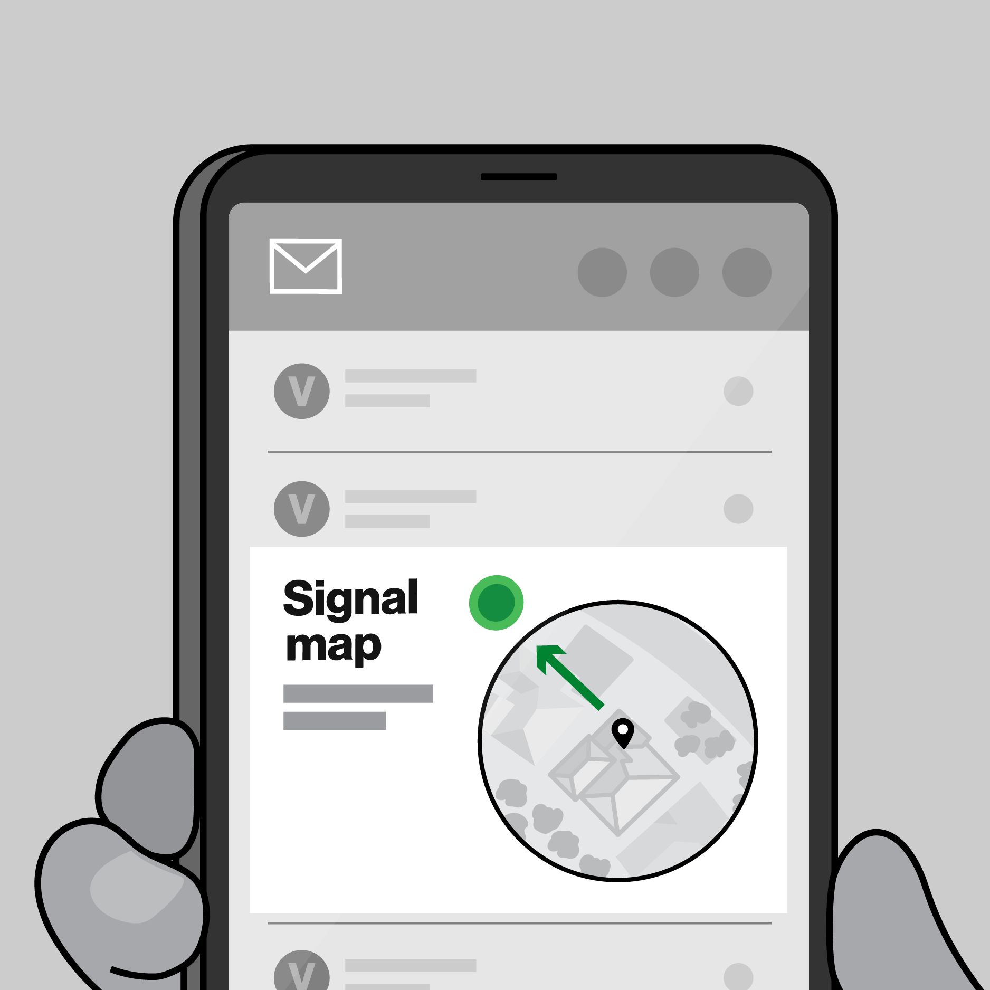
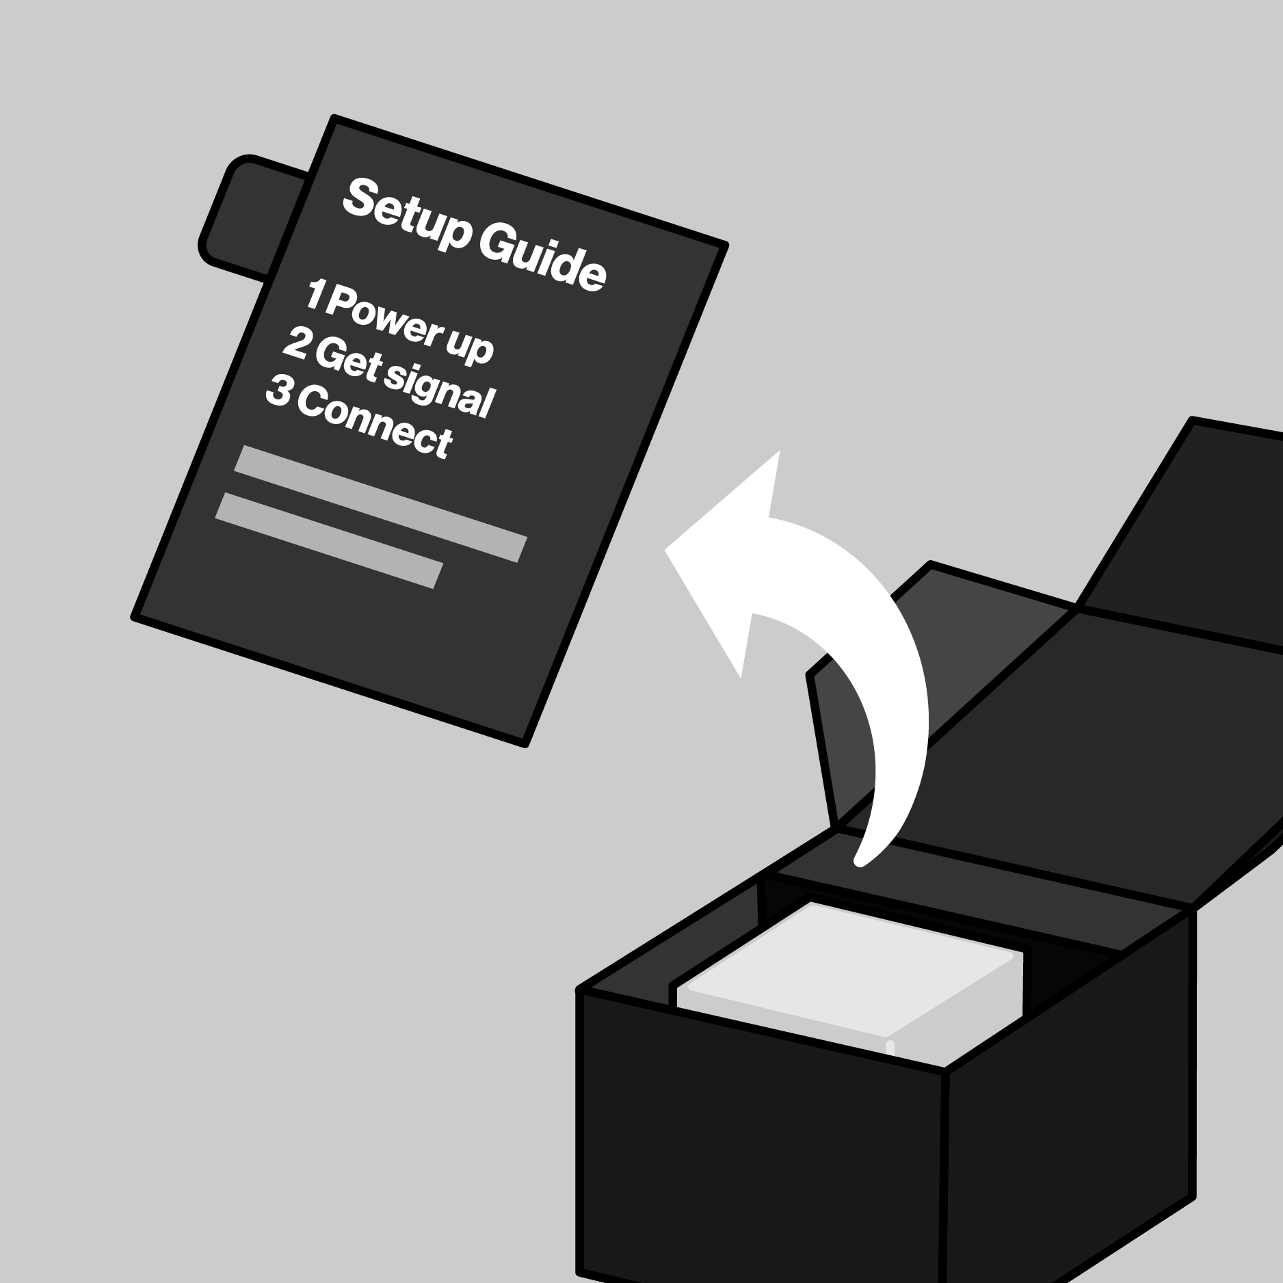


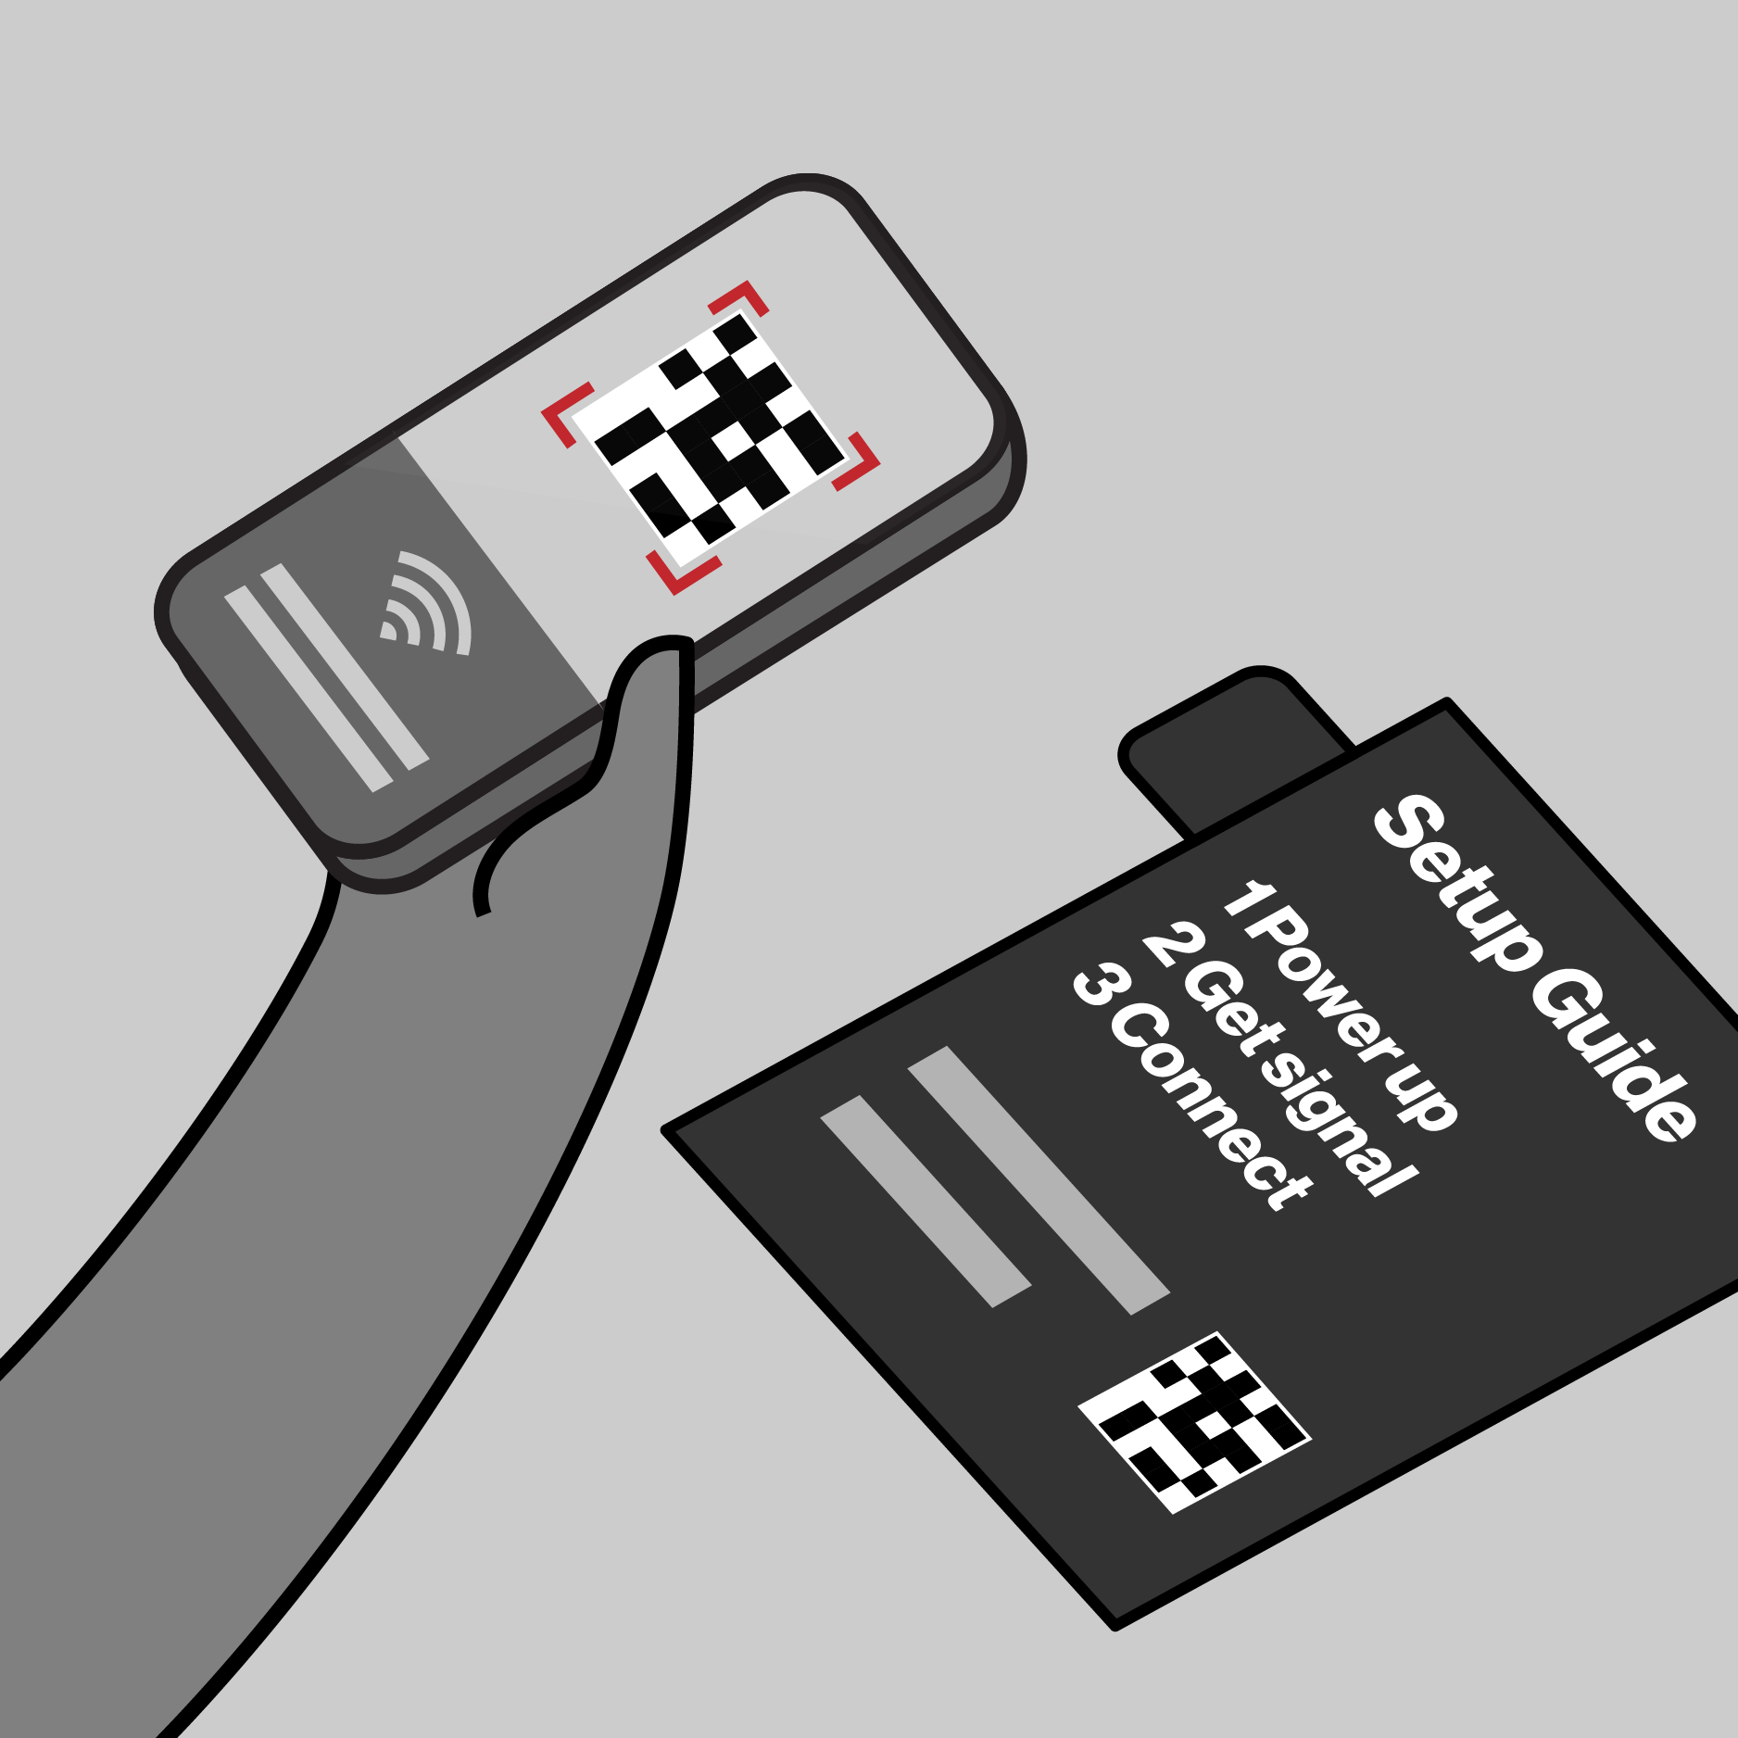
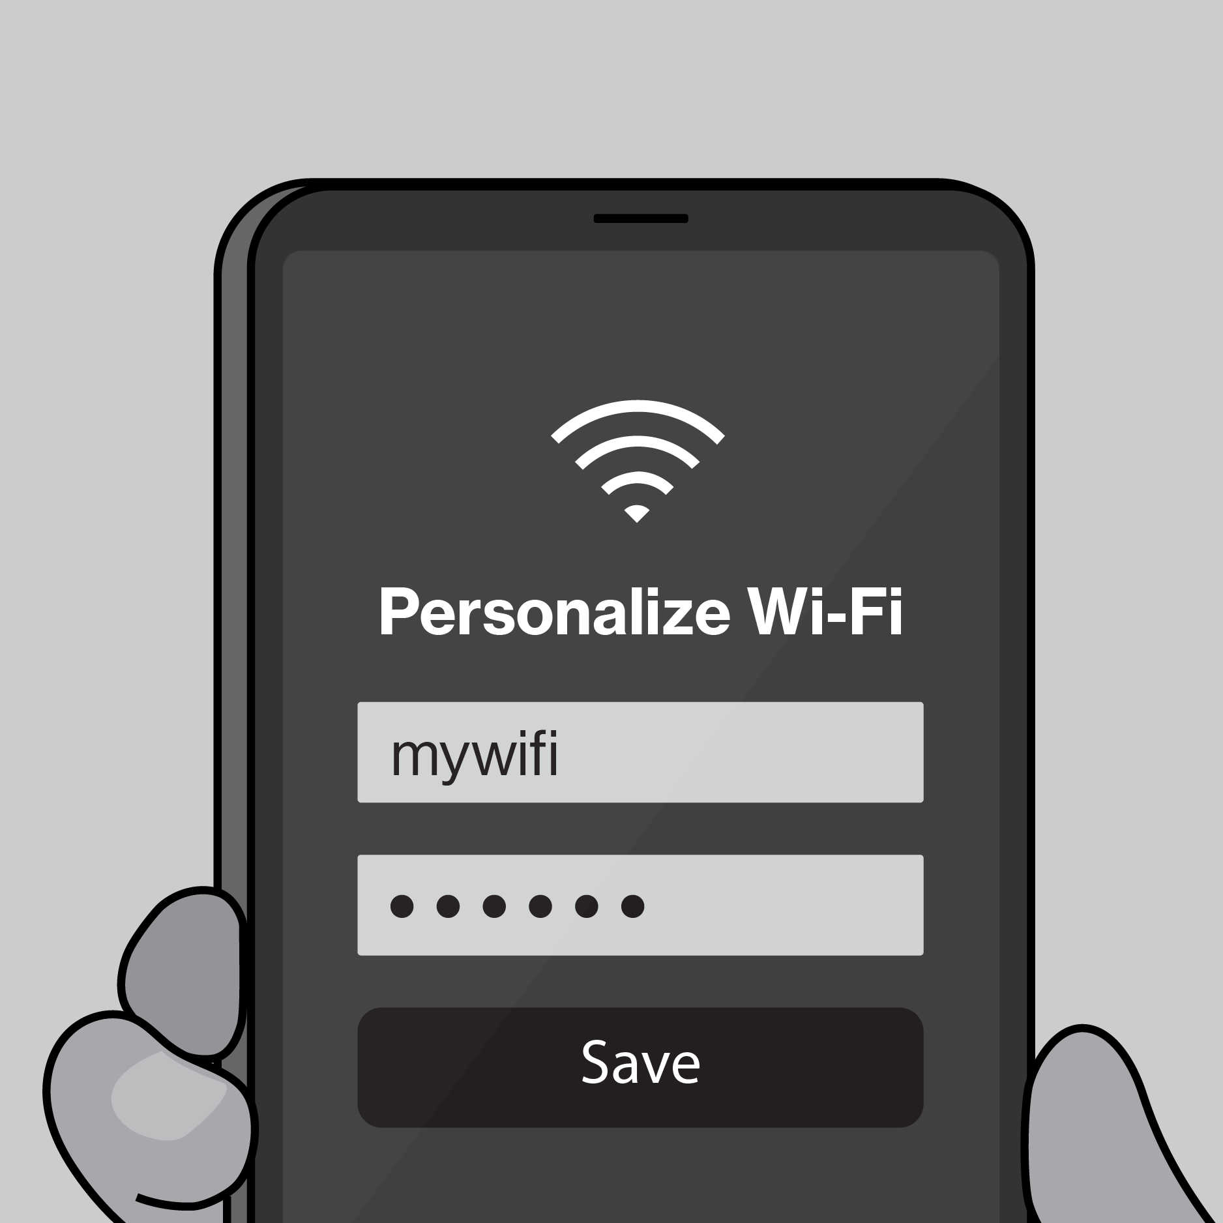

Template
Northstar
Scope
Results
CX Workstream Name
Journey Map Template
Illustrative Only
Key Customer Actions
Description customer objectives and actions
Key Customer Actions
Description customer objectives and interactions
Key Customer Actions
Description customer objectives and interactions
Key Customer Actions Description customer objectives and interactions
Key Customer Actions
Description customer objectives and interactions
Key Customer Actions
Description customer objectives and interactions
Key interactions
Key Interactions w/ Verizon
Key Interactions w/ Verizon
Key Interactions w/ Verizon
Key Interactions w/ Verizon
Key Interactions w/ Verizon
Key Interactions w/ Verizon

Slide 4
Expected Results
Template
Northstar
Scope
Results
CX Workstream Name
KPI’s Impacted- Section 1
CX Excellence
⬜ | Customer Satisfaction (CSAT) |  |  |  | ⬜ | Rep Interaction Score (RIS) |  |  |  | ⬜ | Churn Reduction
⬜ | 3-day Resolve |  |  |  | ⬜ | Digital Interaction Score (DIS)
Revenue Growth
⬜ | Service Product Revenue |  |  |  |  | ⬜ | Overall Conversion
⬜ | Service Product Revenue |  |  |  |  | ⬜ | Prospect Conversion
Operational Efficiency
❎ | Call Volume Optimization (CVO) |  |  |  |  |  | ⬜ | Average Handle Time (AHT)
⬜ | Retail Transaction Time |  |  |  |  |  | ⬜ | Other Cost Savings
Financial Scope & Targets (P*Q)- Section 2
Benefit Value Estimates
Incremental Revenue $_______ Call Volume Optimization $________ Handle Time Optimization $_______ Other Benefit Value $________ (please explain)
Investment Planning - Section 3 (CXO IPG to complete this section)
Capital Investment Estimates
GTS Labor estimate $__________ Non-GTS estimate $__________
Operating Expense for Initiative (Incremental) CXO Operating Cost (OPEX) $________ CXO Incremental Headcount ________
Notes:
Add in a grey box over area that business should not complete for clarity, re-org details

Slide 5
2026 Capex + Opex Incremental
Northstar
Scope
Results
Xxx (i.e. Koenders, Butler etc.) | xxx (i.e. CX, Experience Product, Digital Channel etc.)
Status | Opex ID | Product Area | EMR (see notes) | Initiative Name | Vendor Name | Description | Budget
C | Opex-xxx | Assisted Experience | Contracted Services | <Name> | <Vendor> | <Description> | $XXX.XX
N | New
C | Continue
S | Stop
Notes:
Expense Management Record (EMR) Categories
Advertising and Promotion
Contracted Services
Direct Costs
Full Time Labor
HR and Training
IT and Technology Contracts
Other Operating Costs
Overhead Costs
Professional Services Fees
Sales Incentives
Temporary Labor
Travel and Internal Events

Slide 6
2026 Opex Only
Northstar
Scope
Results
Xxx (i.e. Koenders, Butler etc.) | xxx (i.e. CX, Experience Product, Digital Channel etc.)
Status | Opex ID | Product Area | EMR (see notes) | Initiative Name | Vendor Name | Description | Budget
C | Opex-xxx | Assisted Experience | Contracted Services | <Name> | <Vendor> | <Description> | $XXX.XX
N | New
C | Continue
S | Stop
Notes:
Expense Management Record (EMR) Categories
Advertising and Promotion
Contracted Services
Direct Costs
Full Time Labor
HR and Training
IT and Technology Contracts
Other Operating Costs
Overhead Costs
Professional Services Fees
Sales Incentives
Temporary Labor
Travel and Internal Events

Slide 8
Example
2026 Planning Artifacts
Journey Map Example
Post-Sale / Pre-Setup
Taylor gets a confirmation email to set her up for success.
1. Unbox
On opening the box, Taylor sees a simple 1-2-3 set of instructions for setup
2. Find a spot
Using what she learned in-store, she chooses a spot to plug-in.
3. Activate internet
When the light turns solid white she’s setup. If help is needed, she refers to the 5G Compass in MVA.
Download / Open MVA
If Taylor wants to personalize her network, she can scan the QR code or enter the URL to deep link in My Verizon app.
Personalize internet
Once she has the My Verizon app open, there are a variety of personalizations and settings that she can change.
Key interactions
Confirmation email / Get ready page
Register
Download MVA
5G signal map + compass
Setup guide
Device
Power adapter
LED status
Wi-Fi name/password
5G signal map + compass
Setup guide
My Verizon app
Authentication
My Verizon app
Set Wi-Fi name/password
Connect devices

Slide 9
Master Artifacts
Due 5/19

Slide 10
Appendix

Slide 11
Master Artifact
Initiative Name
Submitter Name
Band 5 Team Name
Core Product
Project

Slide 12
Initiative Name
Workstream Name
Workstream Lead: Name
Initiative Lead: Name
Template
Northstar
Scope
Results
Strategic Themes
[EXAMPLE] Customer need or problem being solved
Giving customers visibility and creating end to end ownership on issues that we cannot resolve on the initial interaction
Customer need or problem is being solved
[What will be unlocked for the customer or business?]
Customer need or problem being solved
[What will be unlocked for the customer or business?]
Customer need or problem being solved
[What will be unlocked for the customer or business?]
Customer need or problem being solved
[What will be unlocked for the customer or business?]
[Northstar statement - Ambition Here]

Slide 13
Template
Northstar
Scope
Results
CX Workstream Name
Journey Map Template
Illustrative Only
Key Customer Actions
Description customer objectives and actions
Key Customer Actions
Description customer objectives and interactions
Key Customer Actions
Description customer objectives and interactions
Key Customer Actions Description customer objectives and interactions
Key Customer Actions
Description customer objectives and interactions
Key Customer Actions
Description customer objectives and interactions
Key interactions
Key Interactions w/ Verizon
Key Interactions w/ Verizon
Key Interactions w/ Verizon
Key Interactions w/ Verizon
Key Interactions w/ Verizon
Key Interactions w/ Verizon

Slide 14
Expected Results
Template
Northstar
Scope
Results
CX Workstream Name
KPI’s Impacted- Section 1
CX Excellence
⬜ | Customer Satisfaction (CSAT) |  |  |  | ⬜ | Rep Interaction Score (RIS) |  |  |  | ⬜ | Churn Reduction
⬜ | 3-day Resolve |  |  |  | ⬜ | Digital Interaction Score (DIS)
Revenue Growth
⬜ | Service Product Revenue |  |  |  |  | ⬜ | Overall Conversion
⬜ | Service Product Revenue |  |  |  |  | ⬜ | Prospect Conversion
Operational Efficiency
❎ | Call Volume Optimization (CVO) |  |  |  |  |  | ⬜ | Average Handle Time (AHT)
⬜ | Retail Transaction Time |  |  |  |  |  | ⬜ | Other Cost Savings
Financial Scope & Targets (P*Q)- Section 2
Benefit Value Estimates
Incremental Revenue $_______ Call Volume Optimization $________ Handle Time Optimization $_______ Other Benefit Value $________ (please explain)
Investment Planning - Section 3 (CXO IPG to complete this section)
Capital Investment Estimates
GTS Labor estimate $__________ Non-GTS estimate $__________
Operating Expense for Initiative (Incremental) CXO Operating Cost (OPEX) $________ CXO Incremental Headcount ________
Notes:
Add in a grey box over area that business should not complete for clarity, re-org details

Slide 15
2026 Capex + Opex Incremental
Northstar
Scope
Results
Xxx (i.e. Koenders, Butler etc.) | xxx (i.e. CX, Experience Product, Digital Channel etc.)
Status | Opex ID | Product Area | EMR (see notes) | Initiative Name | Vendor Name | Description | Budget
C | Opex-xxx | Assisted Experience | Contracted Services | <Name> | <Vendor> | <Description> | $XXX.XX
N | New
C | Continue
S | Stop
Notes:
Expense Management Record (EMR) Categories
Advertising and Promotion
Contracted Services
Direct Costs
Full Time Labor
HR and Training
IT and Technology Contracts
Other Operating Costs
Overhead Costs
Professional Services Fees
Sales Incentives
Temporary Labor
Travel and Internal Events

Slide 16
2026 Opex Only
Northstar
Scope
Results
Xxx (i.e. Koenders, Butler etc.) | xxx (i.e. CX, Experience Product, Digital Channel etc.)
Status | Opex ID | Product Area | EMR (see notes) | Initiative Name | Vendor Name | Description | Budget
C | Opex-xxx | Assisted Experience | Contracted Services | <Name> | <Vendor> | <Description> | $XXX.XX
N | New
C | Continue
S | Stop
Notes:
Expense Management Record (EMR) Categories
Advertising and Promotion
Contracted Services
Direct Costs
Full Time Labor
HR and Training
IT and Technology Contracts
Other Operating Costs
Overhead Costs
Professional Services Fees
Sales Incentives
Temporary Labor
Travel and Internal Events

Slide 18
Example
2026 Planning Artifacts
Journey Map Example
Post-Sale / Pre-Setup
Taylor gets a confirmation email to set her up for success.
1. Unbox
On opening the box, Taylor sees a simple 1-2-3 set of instructions for setup
2. Find a spot
Using what she learned in-store, she chooses a spot to plug-in.
3. Activate internet
When the light turns solid white she’s setup. If help is needed, she refers to the 5G Compass in MVA.
Download / Open MVA
If Taylor wants to personalize her network, she can scan the QR code or enter the URL to deep link in My Verizon app.
Personalize internet
Once she has the My Verizon app open, there are a variety of personalizations and settings that she can change.
Key interactions
Confirmation email / Get ready page
Register
Download MVA
5G signal map + compass
Setup guide
Device
Power adapter
LED status
Wi-Fi name/password
5G signal map + compass
Setup guide
My Verizon app
Authentication
My Verizon app
Set Wi-Fi name/password
Connect devices

Slide 19
Master Artifacts
Due 5/19

